Slide 1




Introduction to Science Communication
Dr Carol Davenport,
Northumbria University

Slide 2
Aims of session
By the end of the session you will:
Understand the breadth of different science communication activities
Be able to simplify written text to explain research concepts
Identify different audiences for science communication activities
Describe your research for a non-specialist audience.

Slide 3
Online session etiquette
Code of conduct
Engage with activities, even when your video/mic is off
Mix of tasks, some individual, some via chat, and some with mic and video on (if possible)
Breakout spaces

Slide 4


Icebreaker
Connect 2 UNRELATED ideas.
Word
2
Word
3
Rocket
Tea
Notes:
Rocket is used to take cosmonauts to the International Space station. Astronauts used a tea bag to identify an oxygen leak on the ISS. (https://www.mirror.co.uk/news/world-news/quick-thinking-cosmonauts-fixed-leak-22859290)

Slide 5








Icebreaker
Create your own connection.
…
…

Slide 6
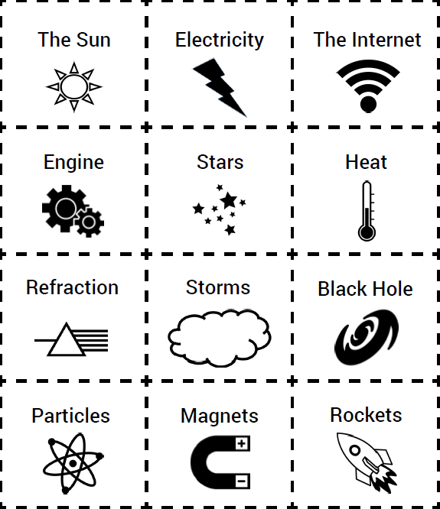
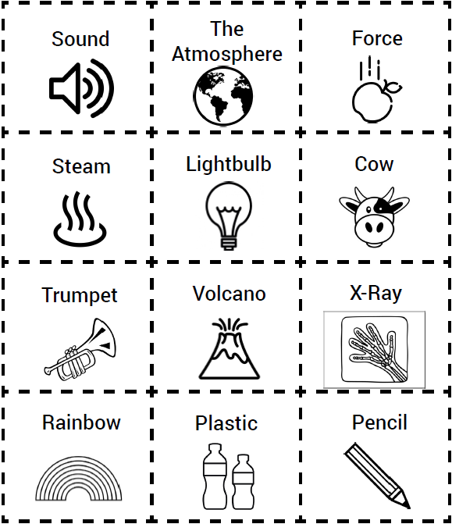

Slide 7
What is science communication?
In the chat write down your own definition of science communication.
If you’d prefer, you could give examples of science communication you have done/seen.

Slide 9
Quick definitions
PUBLIC ENGAGEMENT
A two-way process, involving interaction and listing with the goal of generating mutual benefit.
WIDENING PARTICIPATION
Engagement with social groups under-represented in HE, in order to encourage them to attend university.
SCIENCE COMMUNICATION
The use of skills, media and activity to bring awareness, enjoyment, interest, opinions or understanding of science.
OUTREACH
A one-way discourse, in which scientists communicate their research.

Slide 10
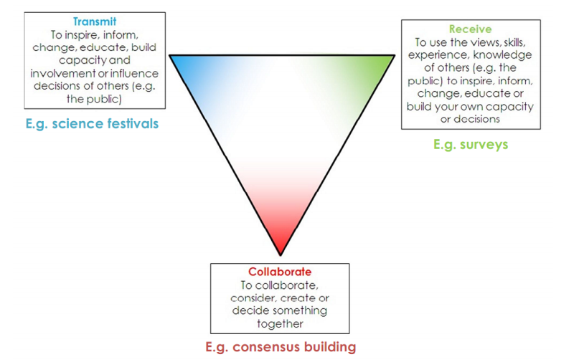
Science for All, 2010

Slide 11
Why do science communication?
In the chat, suggest why researchers and other professionals might want to do science communication activities.

Slide 12
Benefits of doing science communication
Skills development
Career enhancement
Enhancing your research quality and its impact
New research perspectives
Higher personal and institutional profile
Influence and networking opportunities
Forming new collaborations and partnerships
Enjoyment and personal reward
Additional funding
Increasing awareness of the value of research to society
Increasing student recruitment
Inspiring the next generation of researchers

Slide 13
Activity 1: What’s my line?
The following job descriptions were all written by people who had been asked to explain what they did in terms that a 12 year old would understand.
For each example discuss:
What jargon have they included in their description?
Can you work out what they might actually do?
Nominate one person to feed back to the whole group.
(10 minutes)
Notes:
Document found here:
https://docs.google.com/document/d/13dmjiVYm-sudoJ5dsmi3wK8GlsoTtjsoHNdCbN3CCws/edit?usp=sharing

Slide 14
Example 1
I work as a QA engineer. My jobs is to test the Build and ensure it is bug free. Working on differing functionalities is interesting about my job. We explore random new and different features that are built.

Slide 15
Example 2
I work as a project management technician in the water industry, helping to repair and maintain our wastewater assets. I enjoy being involved in projects where we can be sustainable and leave a lasting legacy for our customers. I also get to work with many different organisations to improve the wastewater network and make our construction sites a safer place to work.

Slide 16
Example 3
In my job I combine guidance from different enterprise architecture viewpoints, Business, Information, and Technical to apply solution architecture to a single project. This then assists in the translation of requirements into a solution vision, high level business and/or IT system specifications, and a portfolio of implementation tasks.

Slide 17
Feedback from the groups

Slide 18
To consider:
What are the jargon terms used in your subject area?
What do they actually mean?
Use the chat box to write down some of the jargon terms used in your subject area.
(3 minutes)

Slide 19
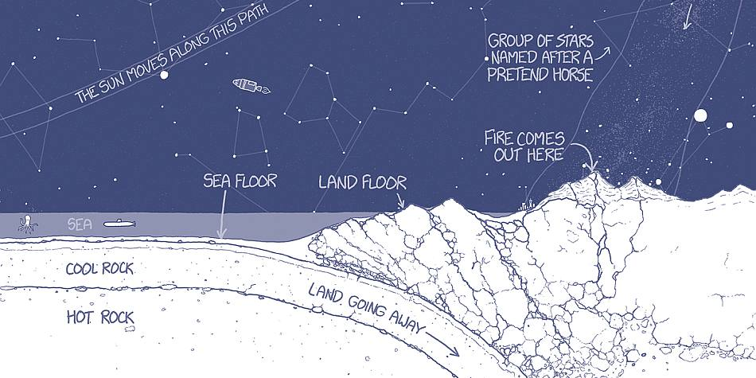
Image taken from Thing Explainer. Randall Munroe
Notes:
The original up goer five cartoon is here: https://xkcd.com/1133/

Slide 20
Activity 2- simplification
Using your research project:
On the shared document write down a summary of your research in a few sentences
Using the simple writer webpage, rewrite your summary to use only the 1000 most common words
Are there any subject specific words that you would want to include?
(Time: 20 minutes)
Notes:
https://xkcd.com/simplewriter/

Slide 21
Break
Stand up, walk about, get a cup of tea.
5 minutes

Slide 22
Share and discuss

Slide 23
Communication golden rule:
know your audience
students | teachers | families | companies | researchers

Slide 24
Who are ‘the public’?
Whilst everyone is a member of the public, there are differences between individuals which profoundly shape their own sense of themselves and their agency. One commonly used tactic is to replace the term 'public' with 'publics', to try to convey this complexity.
NCCPE

Slide 25
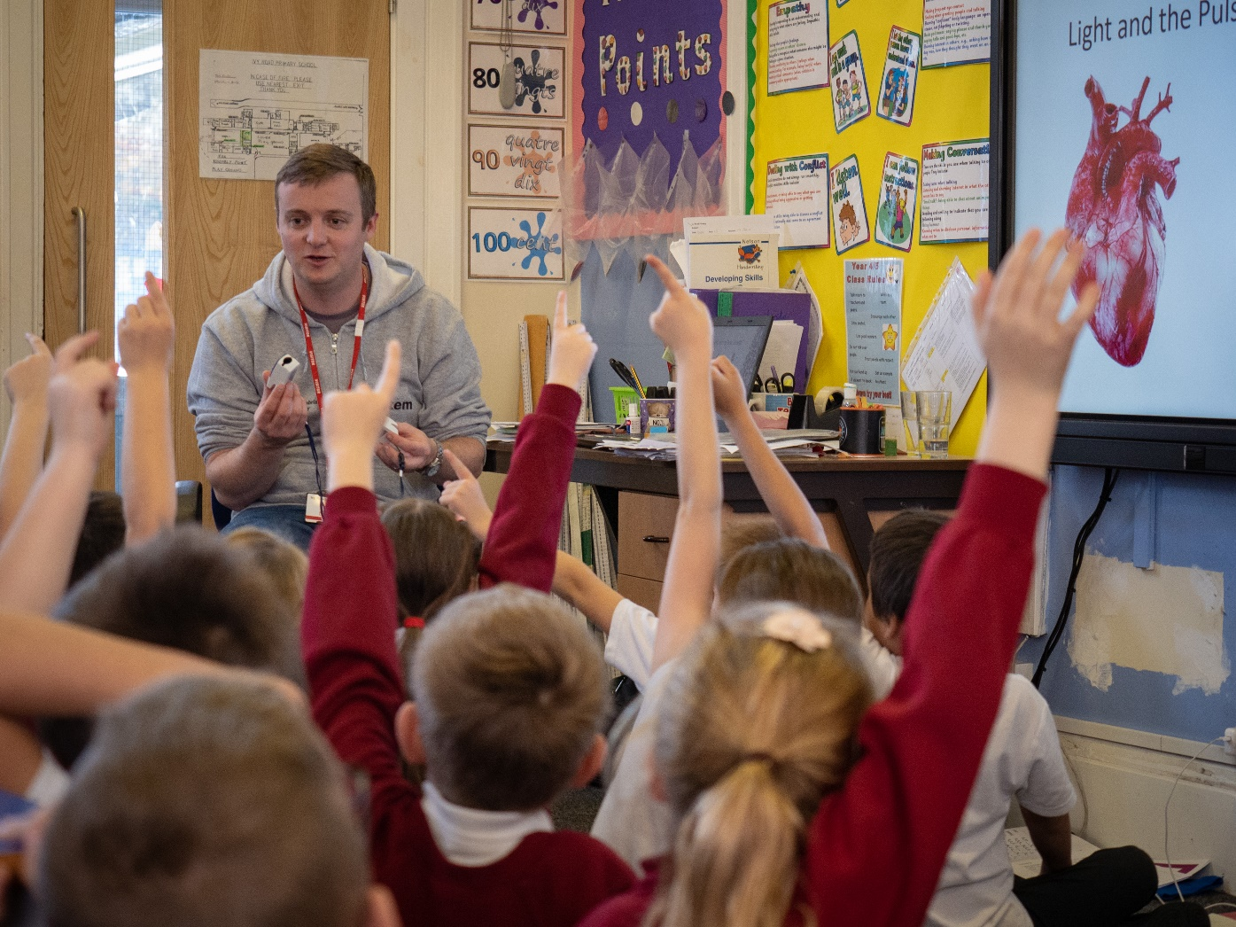
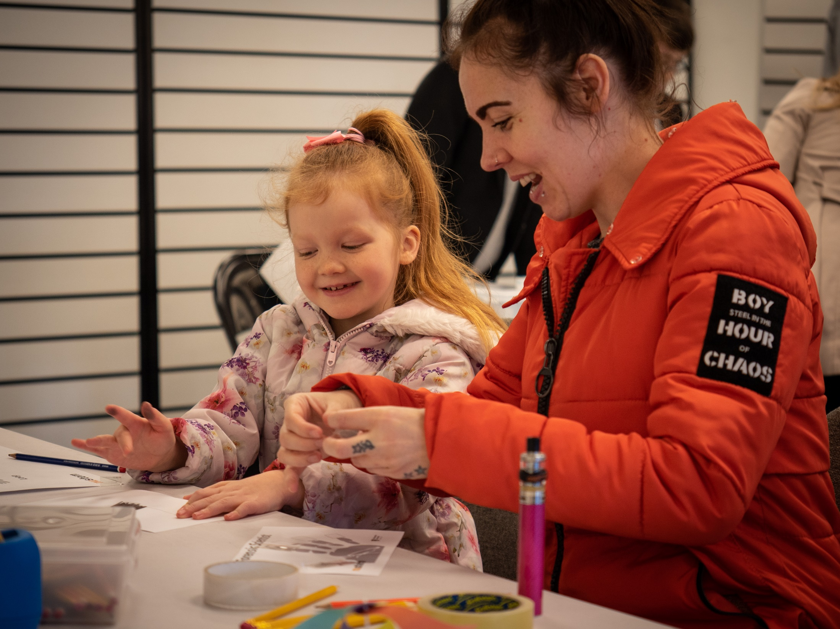
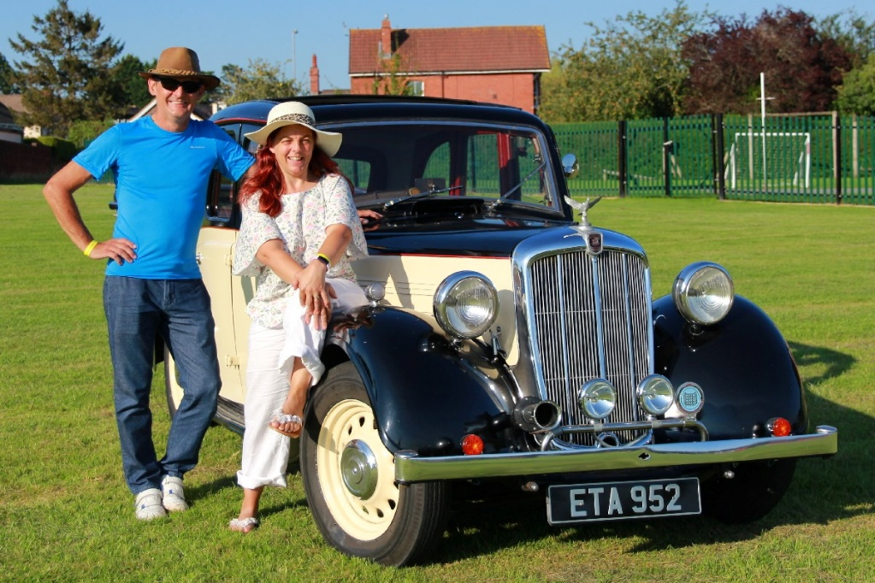
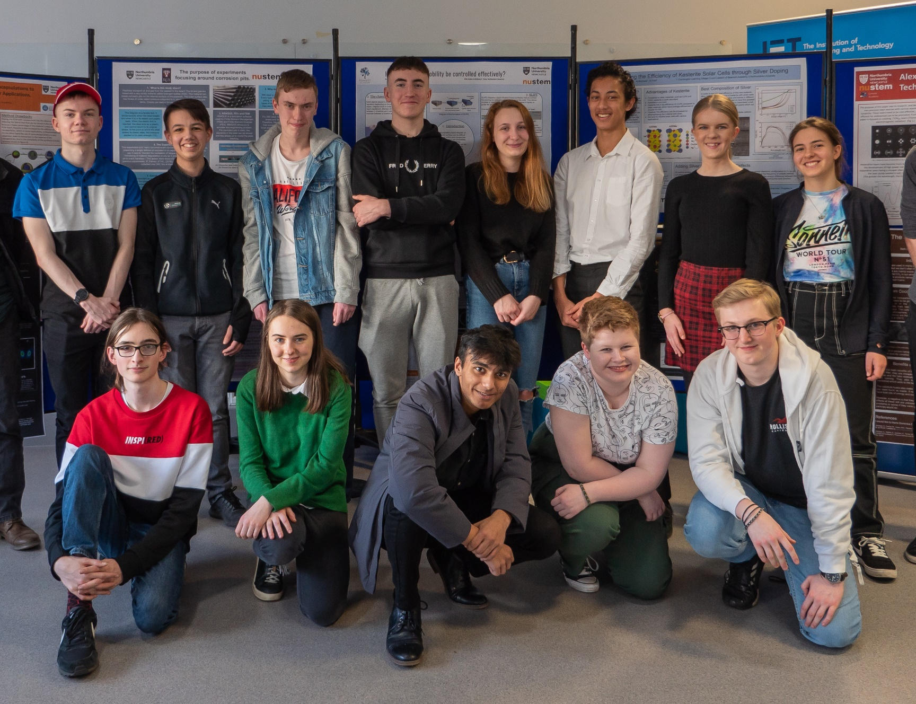
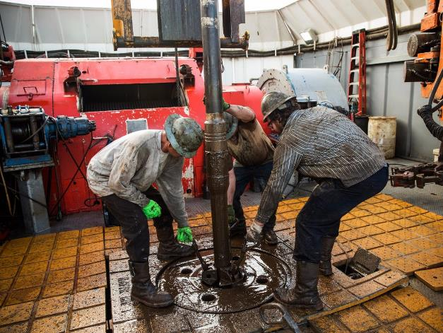
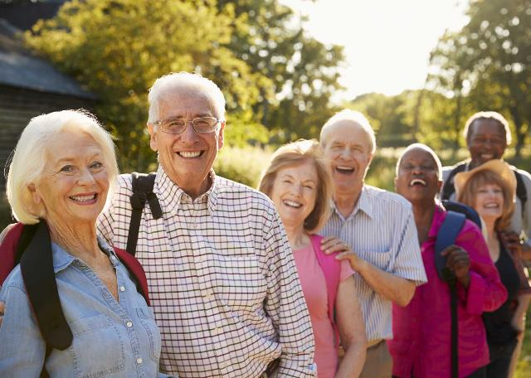
Notes:
Examples of different publics
Schools / children
Families
Teenagers
Oil workers
Classic car enthusiasts
Older adults

Slide 26
From NCCPE
Regarding your audience :
Build a profile of your target group. Make a list of what they do, what they read, what they listen to, where they go, how they like to find out about events. You may have to make some assumptions but be wary of stereotyping

Slide 27
Identifying ‘your public’: market segmentation
Demographic
Behavioural / Lifestyle e.g. Arts Council Audience Spectrum
Income / Class e.g. NRS social grade, Great British Class survey
Role e.g. funders, policy makers

Slide 29
Thinking about your audience
Why might they be interested?
Why might it be important to share your research with them?
What is the ‘hook’?

Slide 30
Activity 4: Half-life your message
In this short activity you will progressively distil the essence of your current research into shorter and shorter statements.
Work in pairs (or threes) in breakout rooms (with mics and videos on).
Notes:
Video here: https://www.youtube.com/watch?v=i8Q7QxJoPZU

Slide 31
What to do:
Stand up
Talk about your research for 1 minute. Try to identify what is the key thing about what you are doing
Now using what you have just said, talk about your research for 30 seconds.
And now for 15 seconds
Finally explain the essence of your research in 8 seconds.

Slide 32
Your audience…
A family member or friend who does not have a scientific background.

Slide 33
Let’s go…
Choose who will speak first
The other person acts as a time-keeper.
Repeat the activity so you both get chance to speak.

Slide 34
Feedback and Reflection
Did you like the central message about your research that emerged from Half-life your message?
Is the central message appropriate for the audience we had in mind?
Did it help you to think about what topics are critical to explaining what you are doing?

Slide 35
Final questions / comments

Slide 36
Thanks for taking part!
Any questions?
carol.davenport@northumbria.ac.uk

